Slide 1


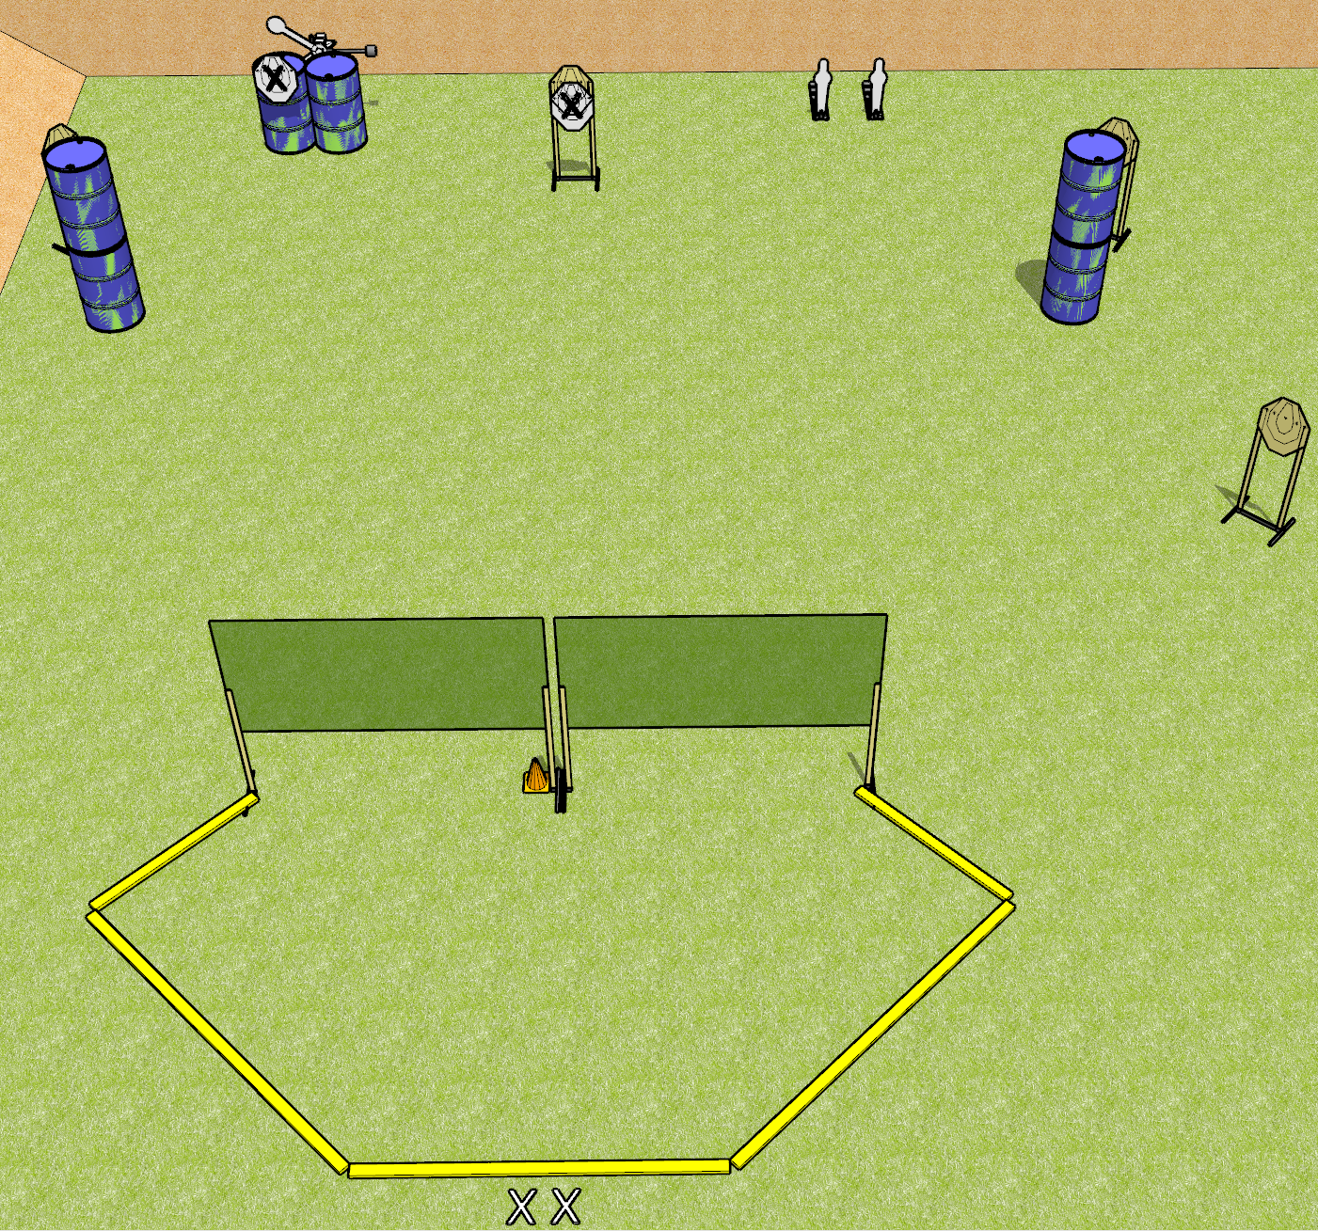
 | Dothan Gun Club – USPSA Match I Need Stitches Course Designer : Drew Coleman
START POSITION : Standing with both feet on X’s, hands relaxed at sides
GUN READY CONDITION : Pistol loaded and holstered. PCC loaded, shouldered, safety on, pointed at orange cone. |  | SCORING: Comstock, 12 rounds TARGETS: 4 paper, 4 Steel SCORED HITS: Best 2 on paper, steel until down START-STOP: Audible, last shot RULES: Failure to perform a reload before the last shot fired will be a procedural penalty.
STAGE PROCEDURE: Engage targets as they become available from within the fault lines. Perform a mandatory reload before the last shot fired.

Slide 2
I Need Stitches
Written Stage Briefing
I Need Stitches is a 12 round, 60 point, Comstock Short Course. There are four IPSC targets, two mini poppers, and two falling plates. The best two hits per target will score. Steel must fall to score. The start signal is audible.
The handgun start position is standing outside the shooting area with both feet on X’s. Handgun is loaded and holstered.
The PCC start position is standing outside the shooting area with both feet on X’s. Loaded carbine held in both hands, safety on, shouldered, muzzle pointed at orange cone.
Upon start signal, engage targets as they become available from within the shooting area. Perform a mandatory reload before the last shot fired.

Slide 3
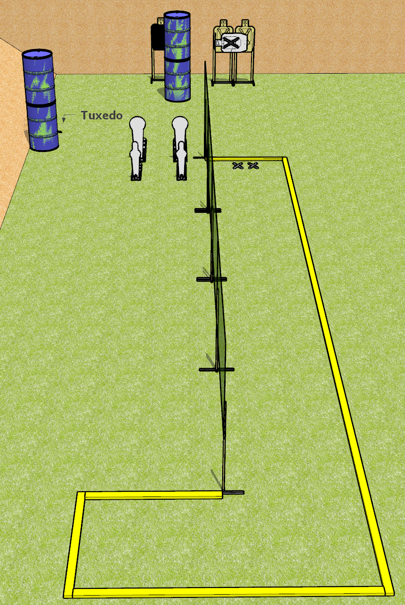
 | Dothan Gun Club – USPSA Match Don’t Trip Course Designer : Drew Coleman
START POSITION : Standing with both feet on X’s, wrists below belt
GUN READY CONDITION : Pistol loaded and holstered. PCC loaded, buttstock on belt, pointed in a safe direction |  | SCORING: Comstock, 12 rounds TARGETS: 4 paper, 4 Steel SCORED HITS: Best 2 on paper, steel until down START-STOP: Audible, last shot RULES:
STAGE PROCEDURE: Engage targets as they become available from within the fault lines.

Slide 4
Don’t Trip
Written Stage Briefing
Don’t Trip is a 12 round, 60 point, Comstock Short course. There are four USPSA paper targets, two Colt Speed Steel targets, and two mini poppers. The best two hits per target will score. Steel must fall to score. The start signal is audible.
The handgun start position is standing inside the shooting area with both feet on X’s, toes touching fault line, hands relaxed at sides. Handgun is loaded and holstered.
The PCC start position is standing inside the shooting area with both feet on X’s, toes touching fault line. Loaded carbine held with both hands, safety on, buttstock on belt, muzzle pointed in a safe direction
Upon start signal, engage targets as they become available from within the shooting area.

Slide 5
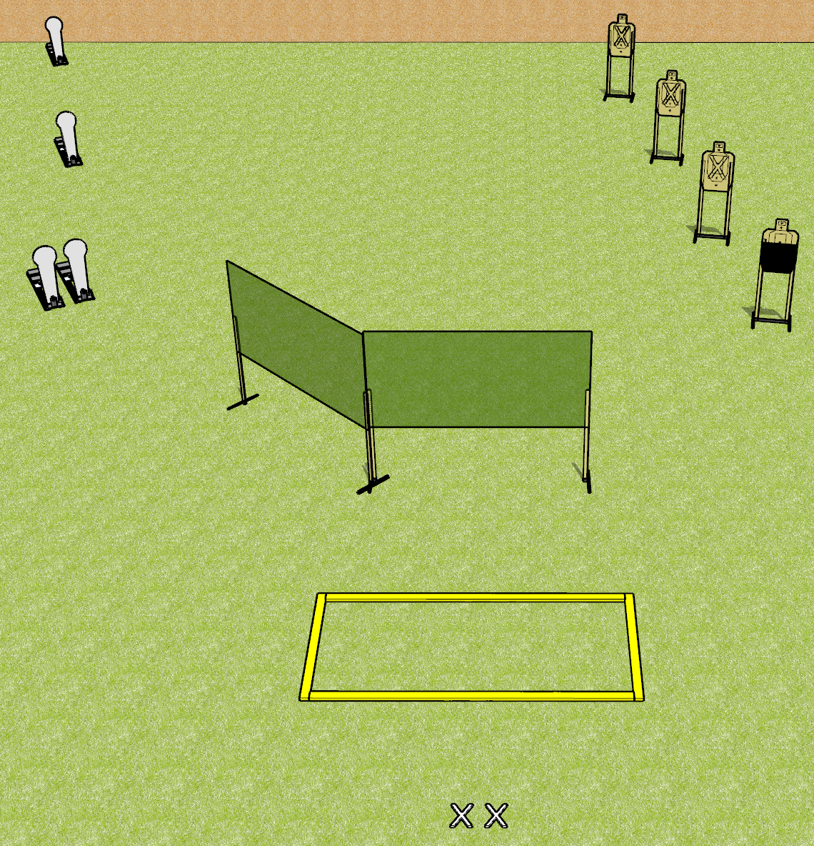
 | Dothan Gun Club – USPSA Match Speed Check Course Designer : Drew Coleman
START POSITION : Standing with both feet on X’s. Hands relaxed at sides.
GUN READY CONDITION : Pistol loaded and holstered. PCC shouldered, safety on, pointed at orange cone. |  | SCORING: Comstock, 12 rounds TARGETS: 4 paper, 4 Steel SCORED HITS: Best 2 on paper, steel until down START-STOP: Audible, last shot RULES:
STAGE PROCEDURE: Engage targets as they become available from within the fault lines

Slide 6
Speed Check
Written Stage Briefing
Speed Check is a 12 round, 60 point, Comstock Short course. There are four USPSA paper targets, and four Colt Speed Steel targets. The best two hits per target will score. Steel must fall to score. The start signal is audible.
The handgun start position is standing outside the shooting area with both feet on X’s, hands relaxed at sides. Handgun is loaded and holstered.
The PCC start position is standing outside the shooting area with both feet on X’s. Loaded carbine held with both hands, safety on, shouldered, muzzle pointed at orange cone.
Upon start signal, engage targets as they become available from within the shooting area.

Slide 7
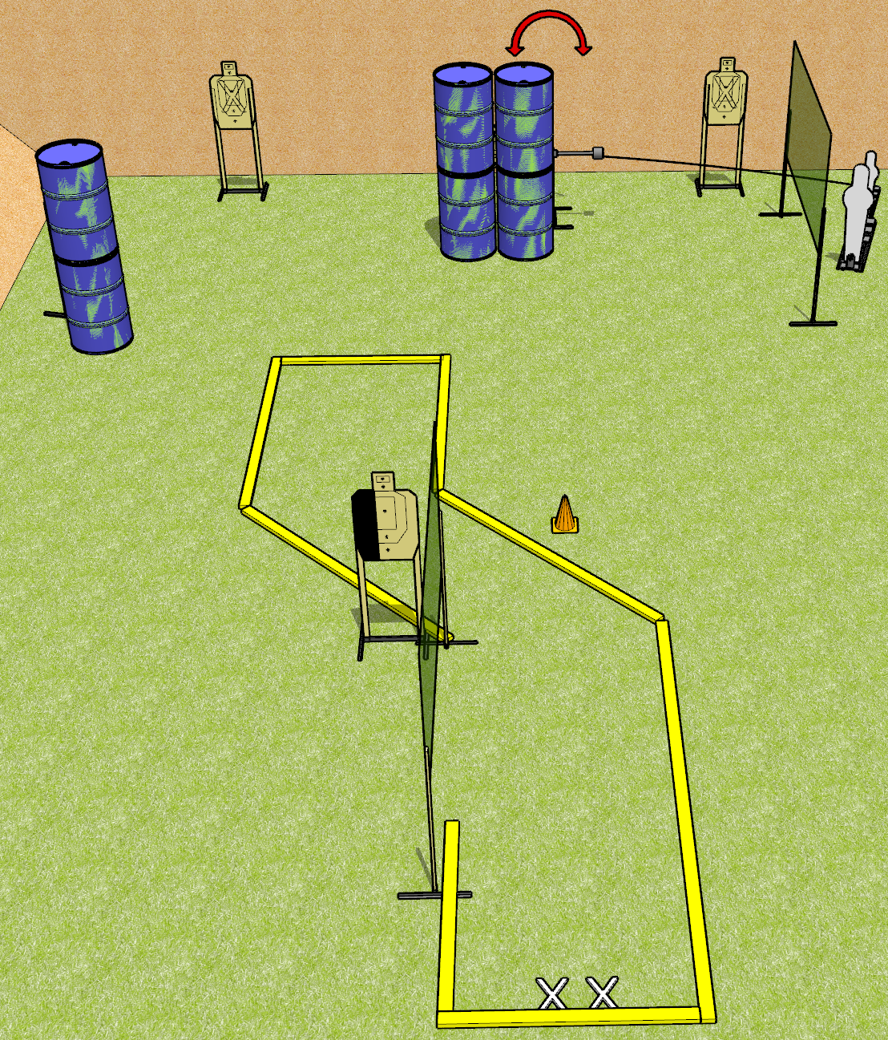
 | Dothan Gun Club – USPSA Match What’s Up Course Designer : Drew Coleman
START POSITION : Standing with both feet on X’s, hands relaxed at sides.
GUN READY CONDITION : Pistol loaded and holstered. PCC loaded, shouldered, safety on, pointed at orange cone. |  | SCORING: Comstock, 12 rounds TARGETS: 5 paper, 2 Steel SCORED HITS: Best 2 on paper, steel until down START-STOP: Audible, last shot RULES:
STAGE PROCEDURE: Engage targets as they become available from within the fault lines.

Slide 8
What’s Up
Written Stage Briefing
What’s Up is a 12 round, 60 point, Comstock Short Course. There are five USPSA paper targets, one pepper popper, and one mini popper. The best two hits will score. Steel must fall to score. The start signal is audible.
Handgun start position is inside the shooting area, both feet on X’s, hands relaxed at sides. Handgun is loaded and holstered.
PCC start position is inside the shooting area, both feet on X’s. Loaded carbine held in both hands, safety on, shouldered, muzzle pointed at orange cone.
Upon start signal, engage targets as they become available from within the shooting area.

Slide 9
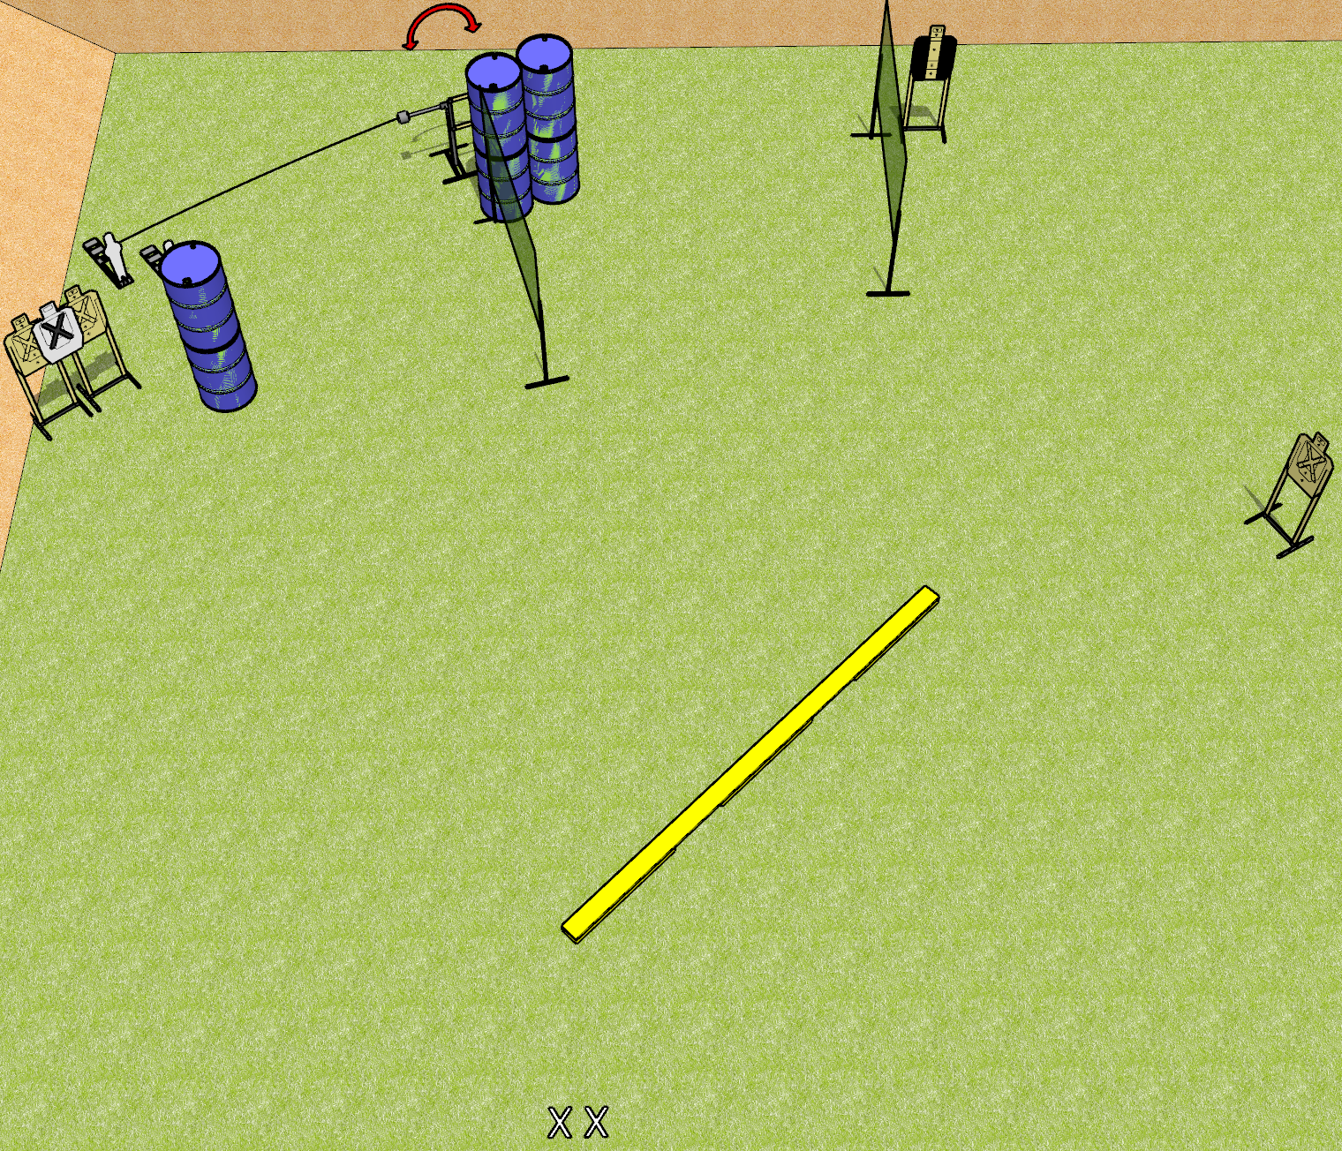
 | Dothan Gun Club – USPSA Match Not the Plank! Course Designer : Drew Coleman
START POSITION : Standing with both feet on X’s, wrists below belt
GUN READY CONDITION : Pistol loaded and holstered. PCC loaded, safety on, buttstock on belt. |  | SCORING: Comstock, 12 rounds TARGETS: 5 paper, 2 Steel SCORED HITS: Best 2 on paper, steel until down START-STOP: Audible, last shot RULES:
STAGE PROCEDURE: Engage targets as they become available from within the fault lines.

Slide 10
Not the Plank!
Written Stage Briefing
Not the Plank! is a 12 round, 60 point, Comstock Short Course. There are 5 USPSA targets and two mini poppers. The best two hits per target will score. Steel must fall to score. The start signal is audible.
Hangun start position is standing with both feet on X’s, wrists below belt. Handgun is loaded and holstered.
PCC start position is standing with both feet on X’s, loaded carbine held with both hands, safety on, buttstock on belt.
On start signal, engage targets as they become available from the plank.

Slide 11
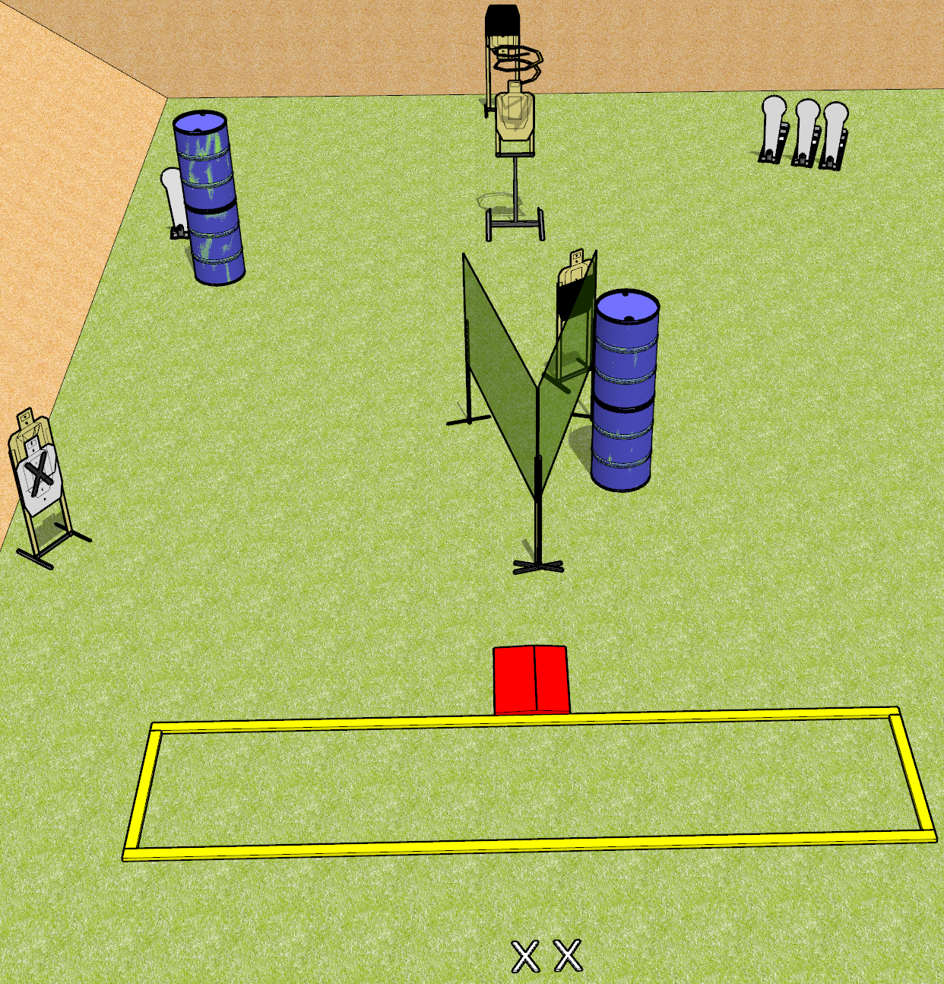
 | Dothan Gun Club – USPSA Match Something Wicked Course Designer : Drew Coleman
START POSITION : Standing with both heels covering X’s, wrists below belt
GUN READY CONDITION : Pistol unloaded and holstered. PCC unloaded, held in both hands with buttstock on belt. |  | SCORING: Comstock, 12 rounds TARGETS: 4 paper, 4 Steel SCORED HITS: Best 2 on paper, steel until down START-STOP: Audible, last shot RULES: The drop turner is a disappearing target and must be activated before last shot fired (9.9.3).
STAGE PROCEDURE: Engage targets as they become available from within the fault lines.

Slide 12
Something Wicked
Written Stage Briefing
Something Wicked is a 12 round, 60 point, Comstock Short Course. There are four USPSA targets and four Colt Speed Steel targets. The best two hits per target will score. The drop turner target is a disappearing target. Steel must fall to score. The start signal is audible.
Handgun start position is standing with both heels covering X’s, wrists below belt. Handgun is unloaded and holstered.
PCC start position is standing with both heels covering X’s, unloaded carbine held with both hands, buttstock on belt.
Upon start signal, engage targets as they become available from within the fault lines. The drop turner target must be activated before the last shot fired, per USPSA rule 9.9.3.

Slide 13
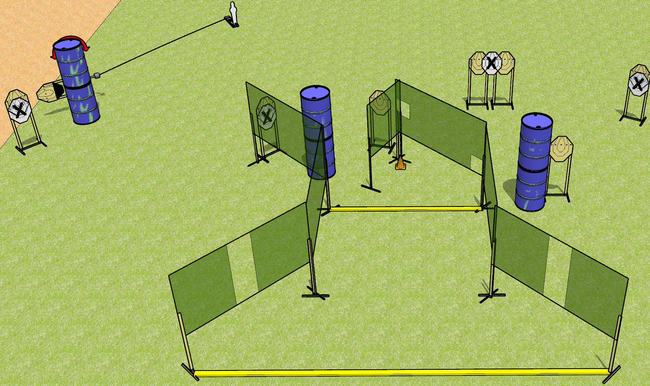
 | Dothan Gun Club – USPSA Match Three Times the Pain Course Designer : Drew Coleman
START POSITION : Standing outside the shooting area, heels touching forward fault line OR toes touching rear fault line, wrists below belt
GUN READY CONDITION : Pistol loaded and holstered. PCC loaded, shouldered, safety on, pointed at orange cone. |  | SCORING: Comstock, 25 rounds TARGETS: 8 paper, 1 Steel SCORED HITS: Best 3 on paper, steel until down START-STOP: Audible, last shot RULES:
STAGE PROCEDURE: Engage targets as they become available from within the fault lines.

Slide 14
Three Times the Pain
Written Stage Briefing
Three Times the Pain is a 25 round, 125 point, Comstock field course. There are eight IPSC targets, and one mini popper. The best three hits per target will score. Steel must fall to score. The start signal is audible.
The handgun start position is standing outside the shooting area with hands relaxed at sides at forward fault line, heels touching fault line, OR standing at rear fault line with toes touching fault line. Handgun is loaded and holstered.
The PCC start position is standing outside the shooting area with hands relaxed at sides at forward fault line, heels touching fault line, OR standing at rear fault line with toes touching fault line. Loaded carbine is held in both hands, safety on, shouldered, muzzle pointed at orange cone.
Upon start signal, engage targets as they become available from within the shooting area.

Slide 15
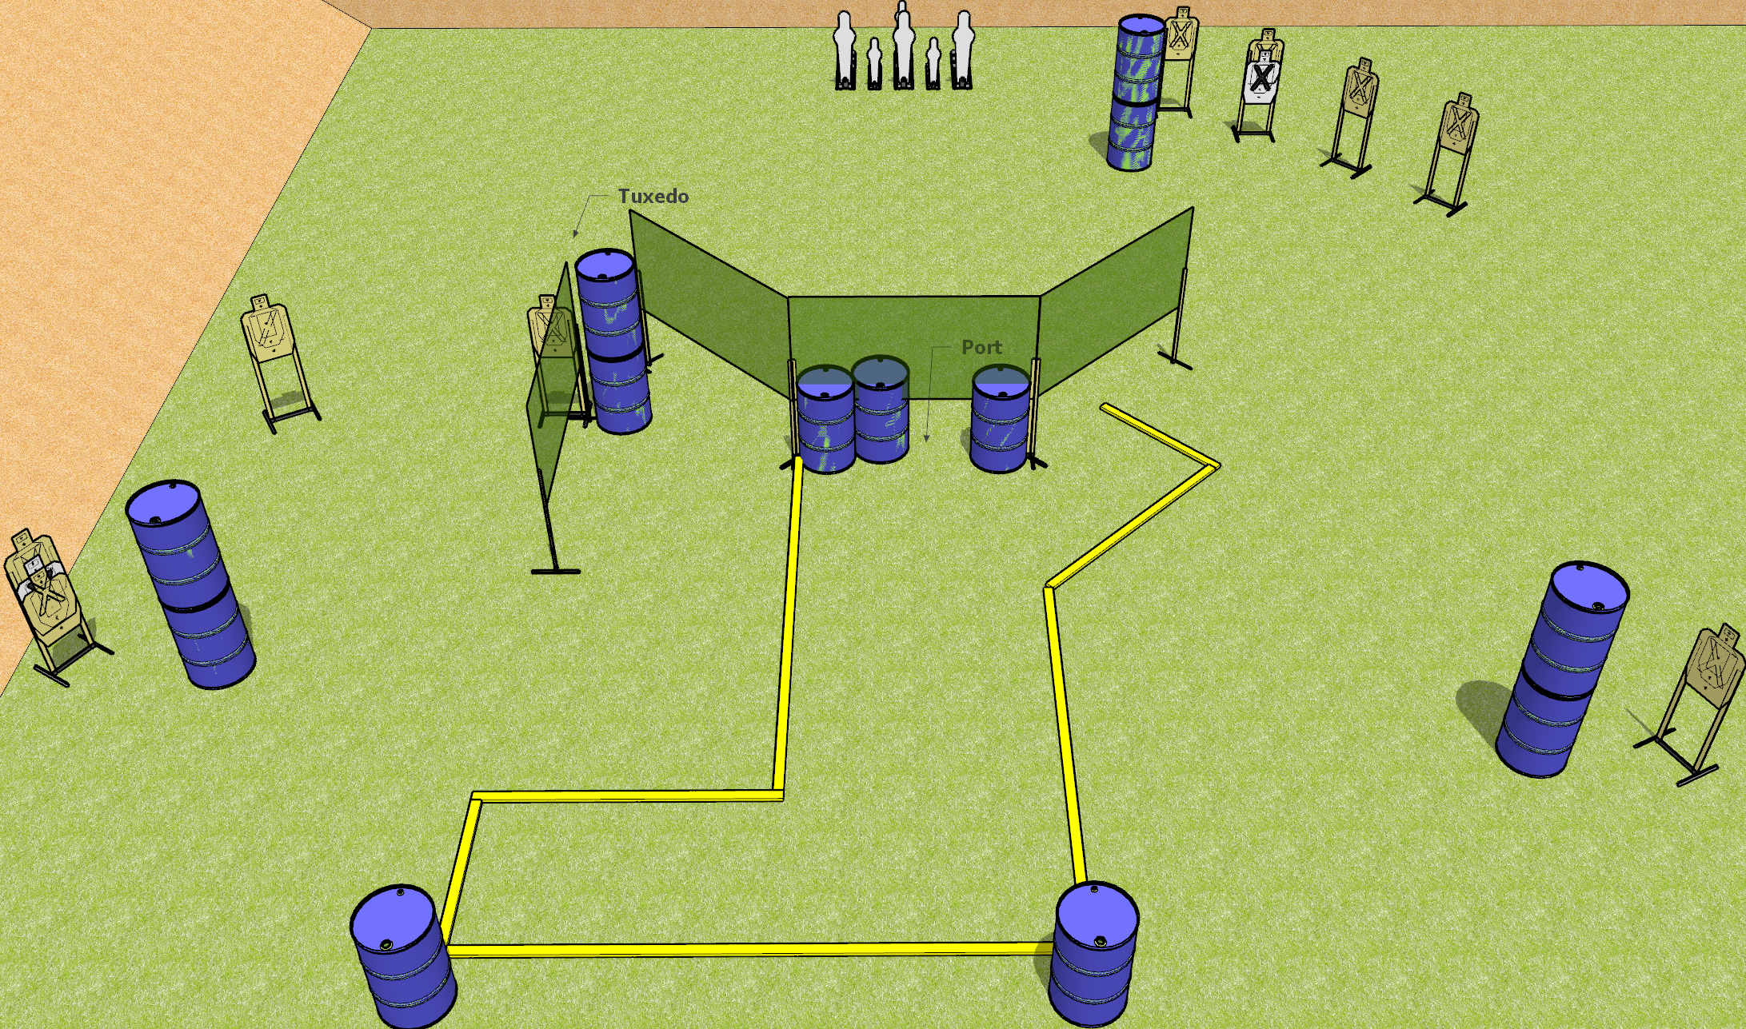
 | Dothan Gun Club – USPSA Match My Knees Hurt Course Designer : Drew Coleman
START POSITION : Standing with palms flat on top of either barrel along the rear fault line, outside the shooting area
GUN READY CONDITION : Pistol/PCC unloaded on opposite barrel from starting position. Muzzle pointed down range, trigger guard on mark. |  | SCORING: Comstock, 26 rounds TARGETS: 10 paper, 6 Steel SCORED HITS: Best 2 on paper, steel until down START-STOP: Audible, last shot RULES: Underneath the forward wall (marked with orange paint and in diagram below) is considered to be a port and may be shot under.
STAGE PROCEDURE: Engage targets as they become available from within the fault lines.

Slide 16
My Knees Hurt
Written Stage Briefing
My Knees Hurt is a 26 round, 130 point, Comstock field course. There are ten USPSA targets, three pepper poppers, and three mini poppers. The best two hits per target will score. Steel must fall to score. The start signal is audible.
The start position is standing outside the shooting area at either barrel at rear of shooting area, with both palms flat on top of the barrel. Unloaded pistol or PCC is placed on the barrel opposite the start position, muzzle pointed down range, trigger guard on mark.
Upon start signal, engage targets as they become available from within the shooting area. The wall marked with orange paint and in the diagram is considered to be a port and may be shot under.

